Slide 1

The Factors to effect MLB Positions Player’s Salary
Herver Yang

Slide 2
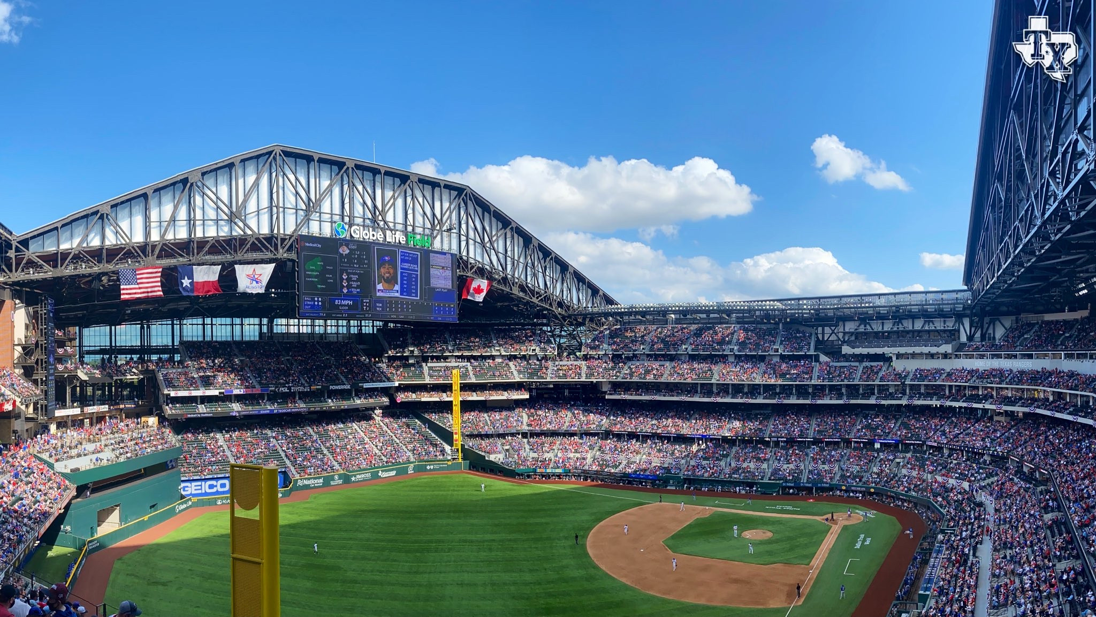
PART 1
Introducing Background & Topic

Slide 3

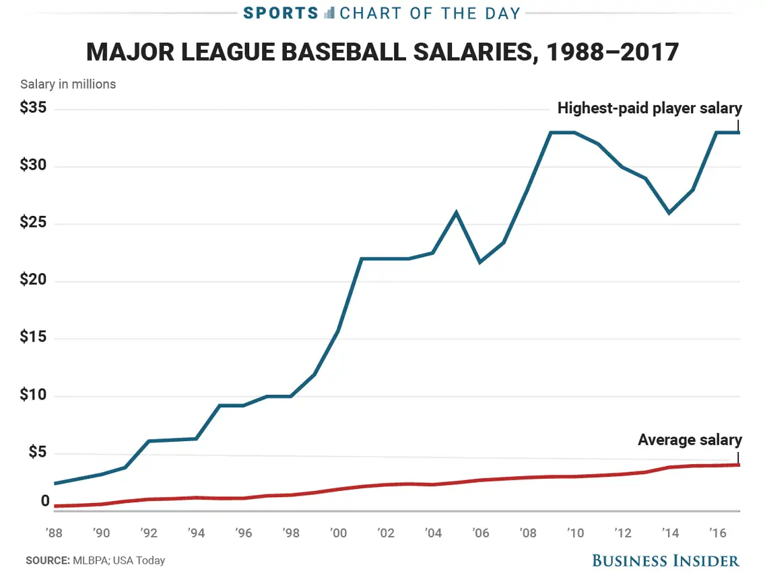

Slide 4
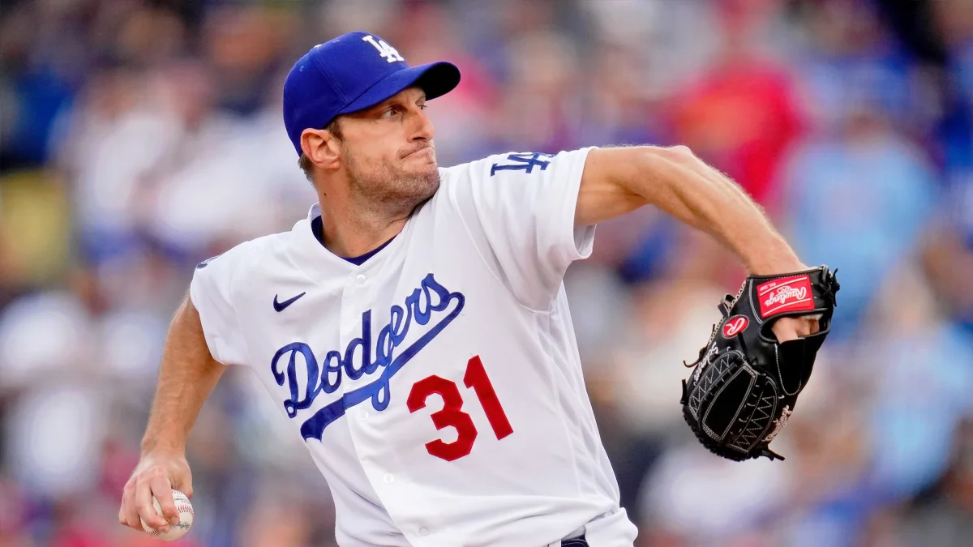
Year | Name | Salary
2022 | Max Scherzer | $43,333,333
2017 | Clayton Kershaw | $33,000,000
2012 | Alex Rodriguez | $30,000,000
2007 | Alex Rodriguez | $27,708,525
2002 | Alex Rodriguez | $25,200,000
2000 | Kevin Brown | $15,714,286
1999 | Albert Belle | $11,949,794

Slide 5
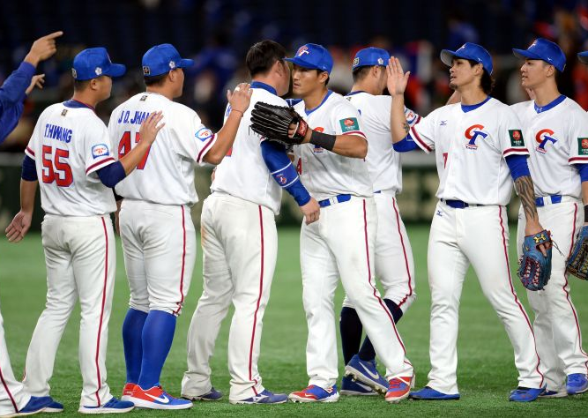
Object
Sample Population
MLB position players who have more than 10 million salary a year
Players’ performance data
https://www.baseball-reference.com/
https://www.spotrac.com/

Slide 6
PART 2
Definition of Variables

Slide 7

Avgsalary
Player’s average salary of contract

Slide 8
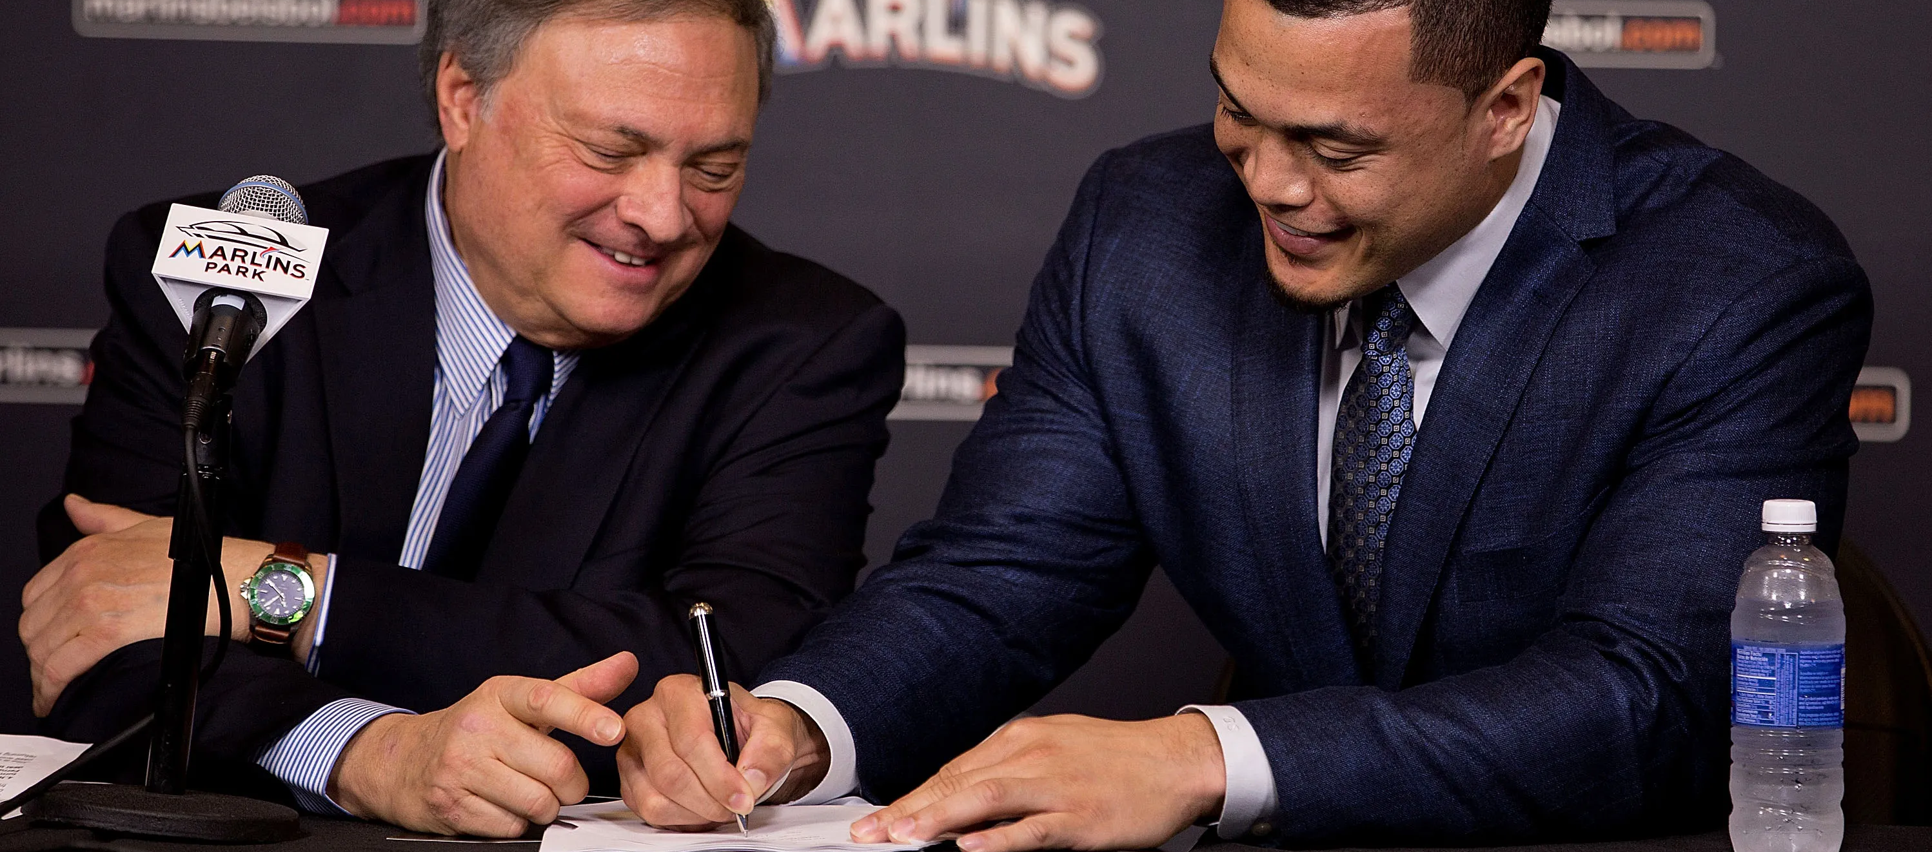
Years
Total years of contract that player signed with the team

Slide 9
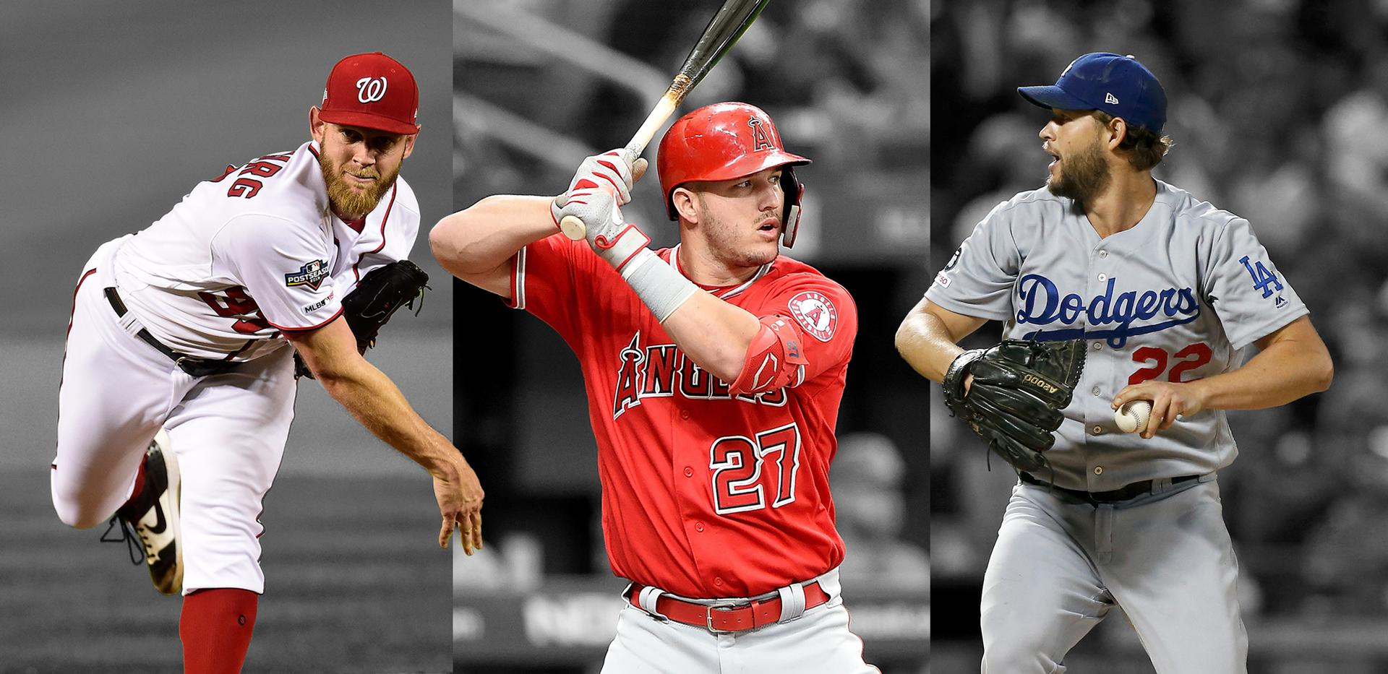
Signedage
Players’ age when they signed the contract

Slide 10
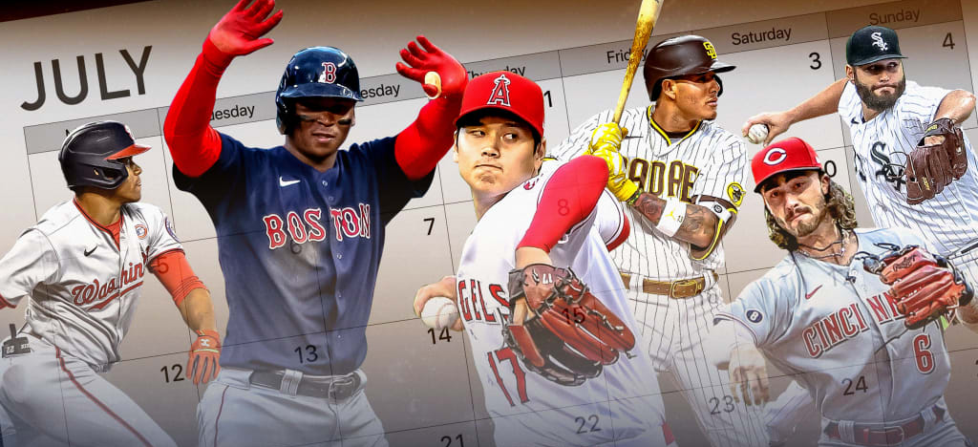
Totsea
Total seasons player has played in major league

Slide 11
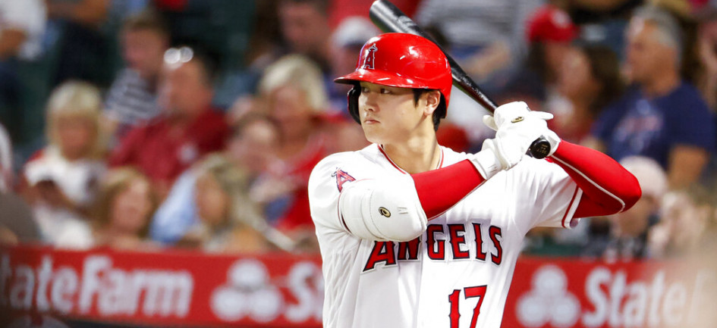
RBI
Run batted in

Slide 12
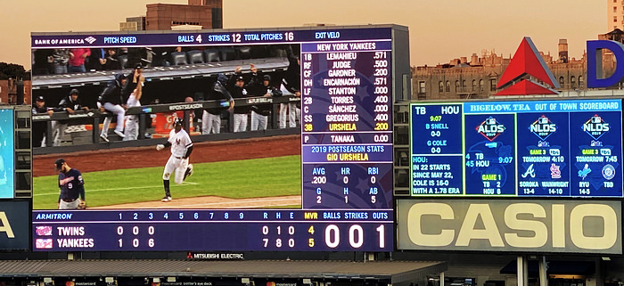
Measures a player’s value in all facets of the game by deciphering how many more wins he’s worth than a replacement-level player at his same position
WAR

Slide 13
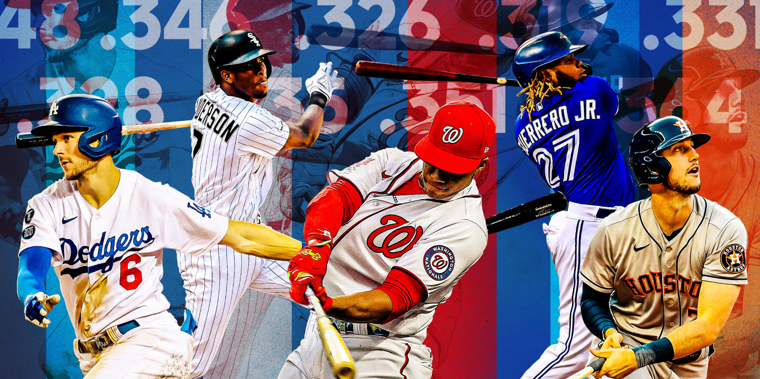
Slugging percentage, it represents the total number of bases a player records per at-bat. Formula for SLG = (1B + 2B*2 + 3B*3 + HR*4)/AB
SLG

Slide 14
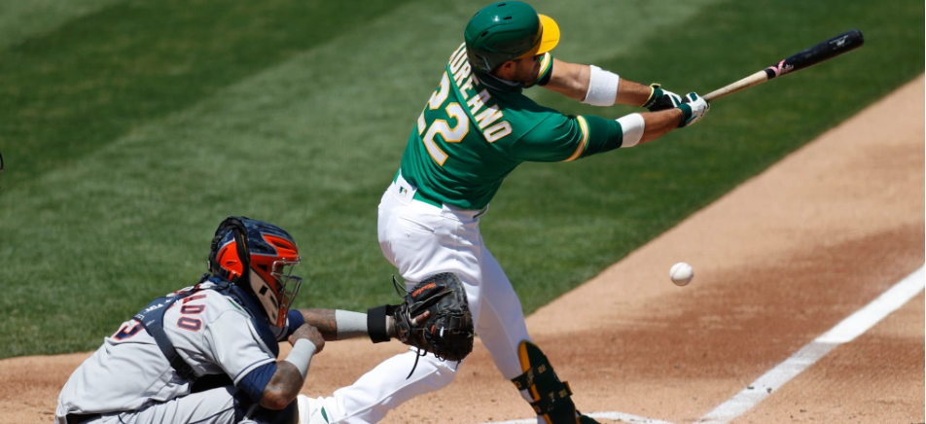
SO%
Strike out percentage. SO/AB

Slide 15
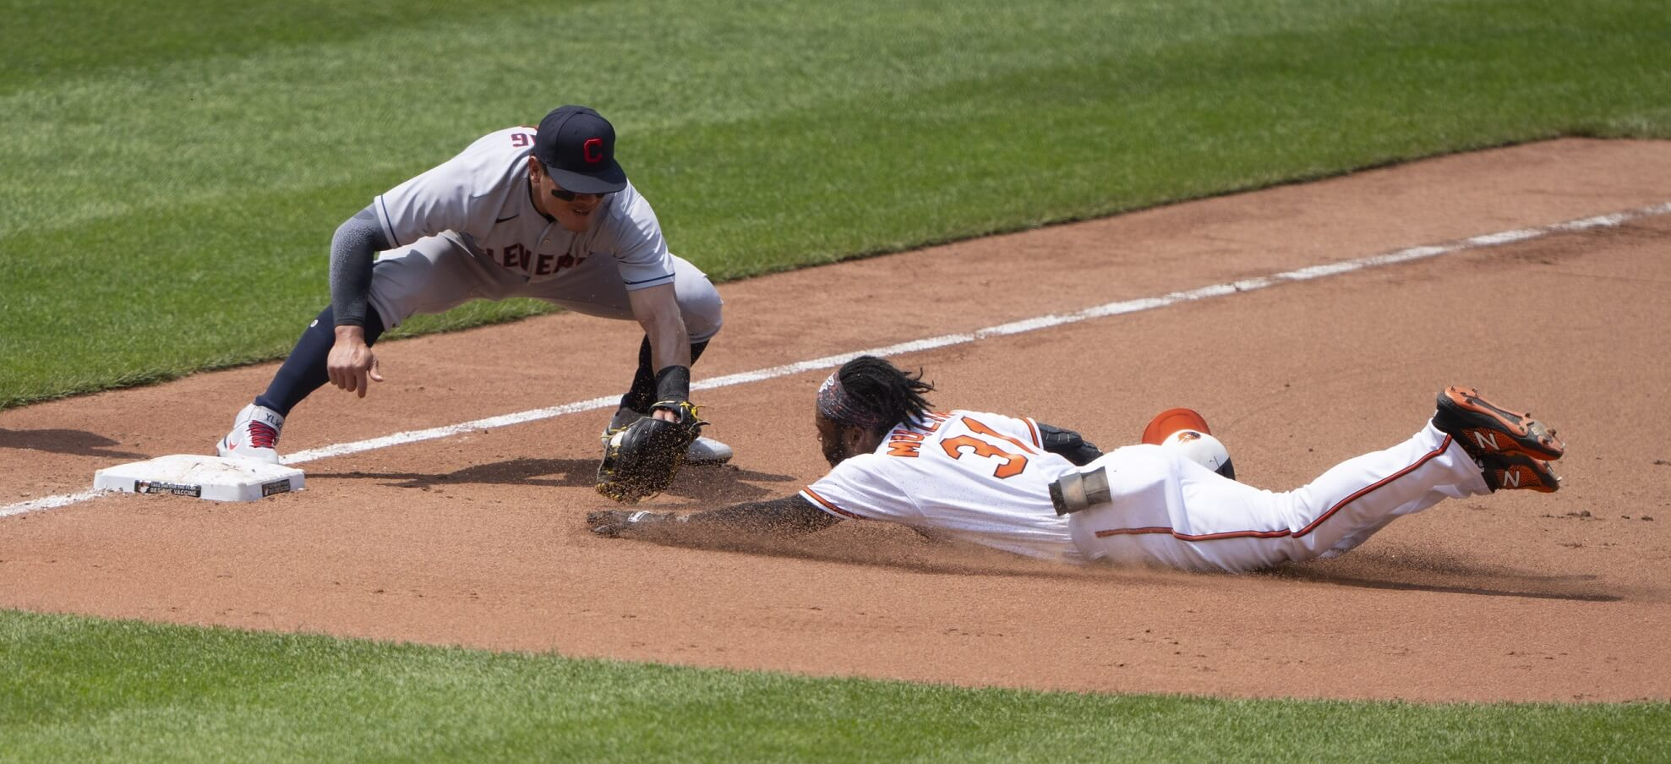
HR, BA, H, TB, R

Slide 16
PART 3
Unrestricted Model

Slide 17

Variables | Coefficients | Standard Error | T-Stat | Mean | Min | Max
Intercept | -24.327 | 14.057 | -1.731
Year(signed) | 1.484 | 0.254 | 5.834 | 5.4 | 1 | 13
Signed Age | 0.879 | 0.282 | 3.119 | 29.3 | 21 | 36
Totsea | -0.363 | 0.331 | -1.096 | 9.4 | 4 | 19
HR | -0.579 | 0.371 | -1.560 | 26.8 | 12 | 45
RBI | 0.224 | 0.110 | 2.025 | 87.8 | 60 | 115
WAR | 1.212 | 0.556 | 2.181 | 4.3 | 1.7 | 9.6
BA | -793.599 | 494.269 | -1.606 | .275 | .233 | .310
H | 1.127 | 0.792 | 1.423 | 163.8 | 124 | 200
TB | -0.584 | 0.461 | -1.266 | 284.6 | 212 | 342
R | 0.003 | 0.089 | 0.039 | 92.6 | 66 | 132
SLG | 430.123 | 279.524 | 1.539 | .479 | .399 | .583
SO% | -0.097 | 0.161 | -0.601 | 20.43 | 10.8 | 29.7
Observations | 67 |  | CV
R Square | 0.681 |  | 1.674

Slide 18
PART 4
Restricted Model

Slide 19

 | Coefficients | Standard Error | T-Stat
Intercept | -28.353 | 10.911 | -2.599
Year(signed) | 1.493 | 0.249 | 5.985
Signed Age | 0.867 | 0.275 | 3.147
Totsea | -0.459 | 0.298 | -1.537
HR | -0.164 | 0.171 | -0.961
RBI | 0.180 | 0.095 | 1.909
WAR | 1.011 | 0.474 | 2.134
SO% | -0.099 | 0.158 | -0.628
TB | 0.018 | 0.035 | 0.511
Observations | 67 |  | CV
R Square | 0.662 |  | 1.672

Slide 20
PART 5
Restricted and Unrestricted Model

Slide 21
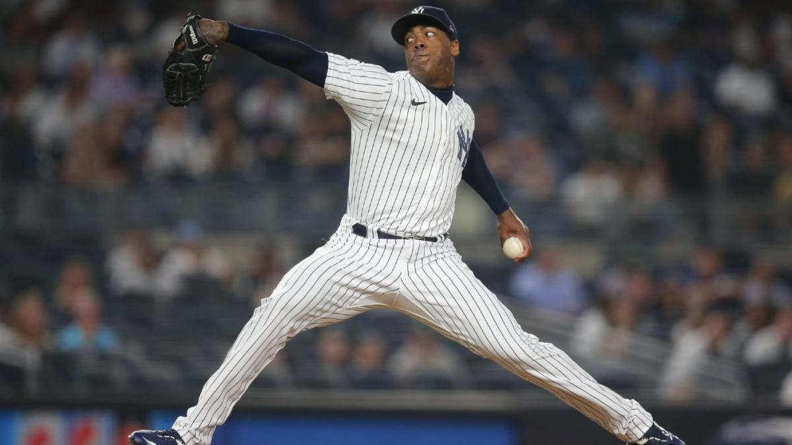
F-test
Critical Value
Result
0.42
2.09
F-Test < Critical Value
Fail to reject, which means it is “Jointly Insignificant” and it is better to use the restricted model

Slide 22
PART 6
Interpret the result

Slide 23
1.49 million dollar more for each additional year of contract. The player who has the long–year contract is usually the all-star level players.
0.87 million dollar for each additional player’s age. Most high-pay players have played in major at least 6 years (free agent).
Year(signed)
Signed Age
1.8 million dollar for each 10 additional RBIs. Player who has high RBIs in single season must be a good hitter in the league.
1.01 million dollar for each additional WAR. 6+WAR is MVP level player, 0-1WAR is scrub player
RBI
WAR

Slide 24

SCRUB | 0-1 WAR
ROLE PLAYER | 1-2 WAR
SOLID STARTER | 2-3 WAR
GOOD PLAYER | 3-4 WAR
ALL-STAR | 4-5 WAR
SUPERSTAR | 5-6WAR
MVP | 6+ WAR
 | MEAN(ALL) | MEAN(> 20) | MEAN(> 10)
WAR | 4.3 | 5.1 | 3.6
SALARY | 19.57 | 25.933 | 14.412
RBI | 87.84 | 93.13 | 83.54
HR | 26.8 | 28.8 | 25.2
H | 163.8 | 172.0 | 157.2
TB | 284.6 | 301 | 271

Slide 25
PART 7
CONCLUSION

